Slide 1
Reckitt Benckiser
Crayon and Flexera Services

Slide 2





Govern & Optimize
Governance and Optimization Services for Software and Cloud
Maturity Assessment Service
IT Governance Services
License Optimization Services
Software & Cloud Economics Services
SAM Tool Services
Rightsize your IT estate for a cloud future
Assess & Migrate
Optimize your hybrid and multi-cloud environment
Govern & Optimize
Operate & Support
Secure and managed modern workplace
Innovate & Accelerate
Innovate with a scalable data platform, AI and IoT

Slide 3


Governance & Lifecycle Management Framework
Assess
Build
Manage
Scope and plan next steps for SAM and cloud spend management
Build a solid governance foundation
Monetized optimization of software licenses estate and/or cloud consumption and subscription

Slide 4



Utilize a dedicated SAM tool towards software asset management
Crayon service: SAM TOOL SERVICES
Are you looking to acquire a dedicated tool to manage your software assets or do you already have a tool that needs a health check? With Crayon SAM Tool Services, we offer you technical services related to managing software assets in a dedicated SAM tool. Our SAM Tool Services cover the entire lifecycle from assessing which tool is right for you, technical implementation, regular maintenance and health checks to optimization of existing systems.
Take informed decisions regarding a SAM tool for your organization
Let certified tool experts handle the implementation of your new SAM tool
Leverage our SAM tool experts to ensure your SAM tool is running as it should.

Slide 5
Crayon and Flexera Partnership
Australia experience?

Slide 6
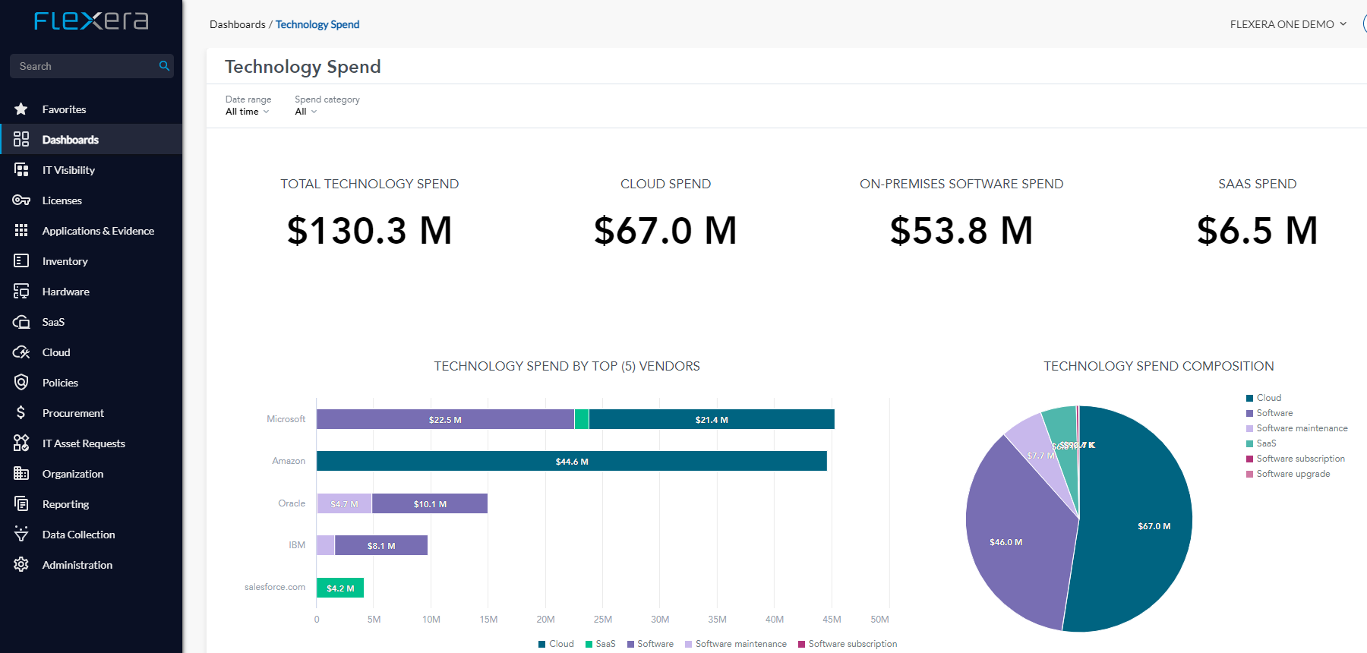
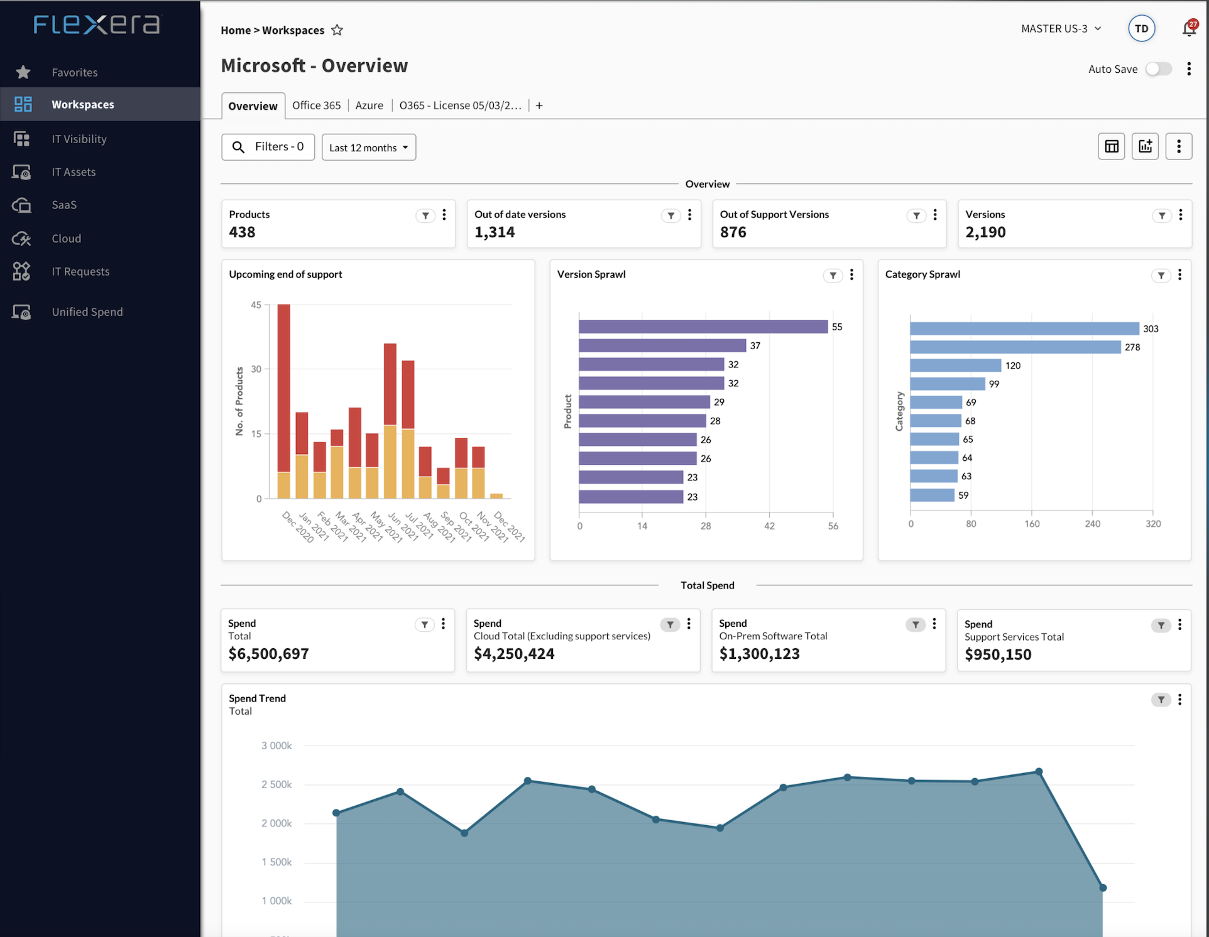
Managing Complex Vendors
Crayon and Flexera Services:
Software License Optimisation Insights
Streamline your software license optimisation process with Flexera through product use rights such as license entitlements provided by software purchase agreements
Enterprise agreements (EA)
MPSA (Microsoft Products and Services Agreement)
Software Assurance (SA)
Adobe Cumulative License Program (CLP)
Reduce your organization’s software audit true-up costs by examining your use rights

Slide 7



Managing Complex Vendors
Crayon and Flexera Services:
Reduce unplanned software expenses with a solution verified by Oracle
Automate your Oracle discovery and inventory process across Windows, Linux and UNIX platforms
Accurately calculate Oracle license consumption even when utilizing virtualization, hard partitioning and clustering technologies
Conduct informed vendor negotiations and software purchases.
Certified by IBM as a replacement for ILMT measurement of sub- capacity licenses.
Coverage of IBM License metrics such as Processor, PVU, UVU, RVU and others.
Comprehensive list of IBM products recognized o-o-t-b.
Know exactly who is using SAP and to what extent
Optimize ongoing SAP license costs
Ensure compliance by assigning each user the optimal named-user license
Minimize duplicate users and idle licenses
Accurately budget for future SAP license requirements

Slide 8
Audit Readiness
Crayon and Flexera Services:
By deploying Flexera ITAM, you are able to automate the data collection and interpretation of the license position, to enable you to focus on remediating remaining gaps that you have uncovered and matters to be audit ready.
Rather than spending 1 year of full team focusing on this on top of BAU, you are in a strong position to close down the audit cycle with the confidence to drive down unbudgeted cost.
Discovery Challenges without an ITAM Solution
Scope (how many servers, desktops, VDIs in the DC, outsourced? User base? GEO?)
Contract clause and entitlements (where are they? Are they complete? Do you have all historical contract clauses?)
Global organizational context (Where are these assets? Who use what? How are users accessing these software?)
Installations (what data sources and method do you use to compile the report? Are they complete and accurate?)
Usage (what data sources are used to contextualize the usage? What’s your process/frequency of updates?)
Visibility (how do you know you have covered all products/assets in scope? What are the processes?)
Due to pro-longed of the audit cycle, data changes so quickly in the environment and the whole process is taking even longer to reconcile with a poor solution.

Slide 9
How We Enable Value
Crayon and Flexera Services:
Software Economics
FlexeraOne
Data Collection
Data Processing & Analysis
Key deliverables
Value
Data collection from SAM tool
Metering data from SAM tool
Gather license entitlements and purchase history
Validation of data and tool coverage
Import and configuration of license entitlement in Flexera
Reconciliation of compliance status
Analysis of compliance risk and optimisation opportunities
Quarterly compliance & optimisation report
Monthly optimisation recommendations
Project management
Implementation recommendations report
Management summary Report
Financial ROI Report
Knowledge Share with Internal Reckitt team
Ongoing optimisation of software licensing spend
Budget predictability
Simplify reporting and free up your internal resources
Minimise risk related to over licensing and under licensing
Documented savings and cost avoidance

Slide 10

Implementation of FlexeraOne
Crayon and Flexera Services:
Q1 – FlexeraOne Deployment & Configuration
Q2 – Licence Optimisation & Configuration
Q3 – Licence Optimisation
Q4 – Licence Optimisation
Agent Deployment
Tool Configuration and Implementation
License Review & Optimisation
SAM Tool Licence Upload & Configuration
Software Metering and SaaS usage Reporting
SAM Tool Compliance & Optimisation Reporting
Software Metering and SaaS Usage Reporting
SAM Tool Licence Update
SAM Tool Compliance & Optimisation Reporting
Software Metering and SaaS Usage Reporting
SAM Tool Licence Update

